Slide 1


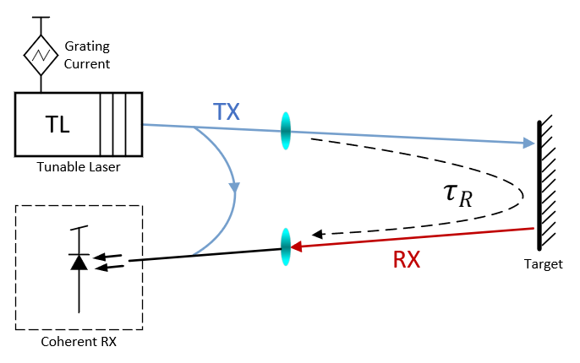
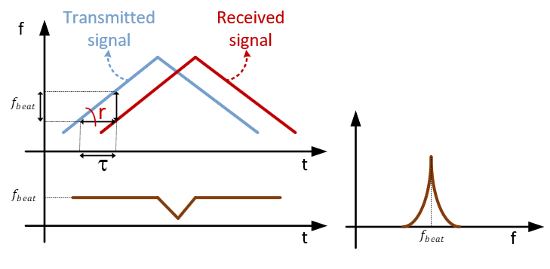
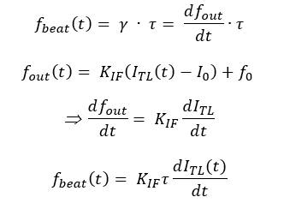

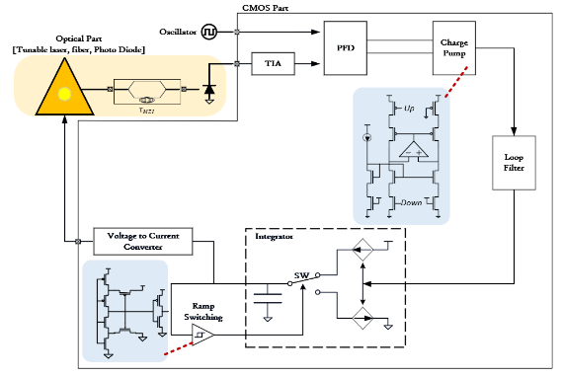
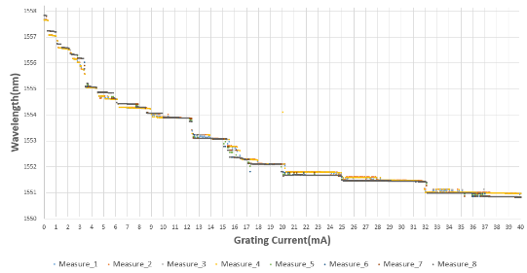
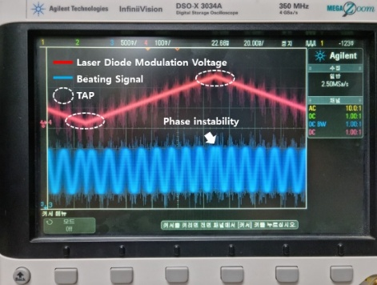
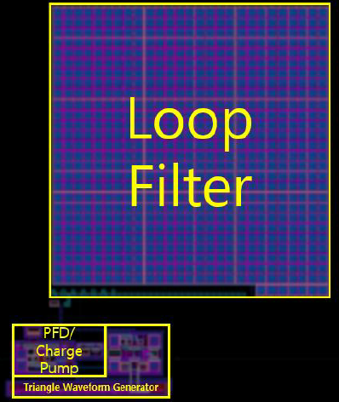
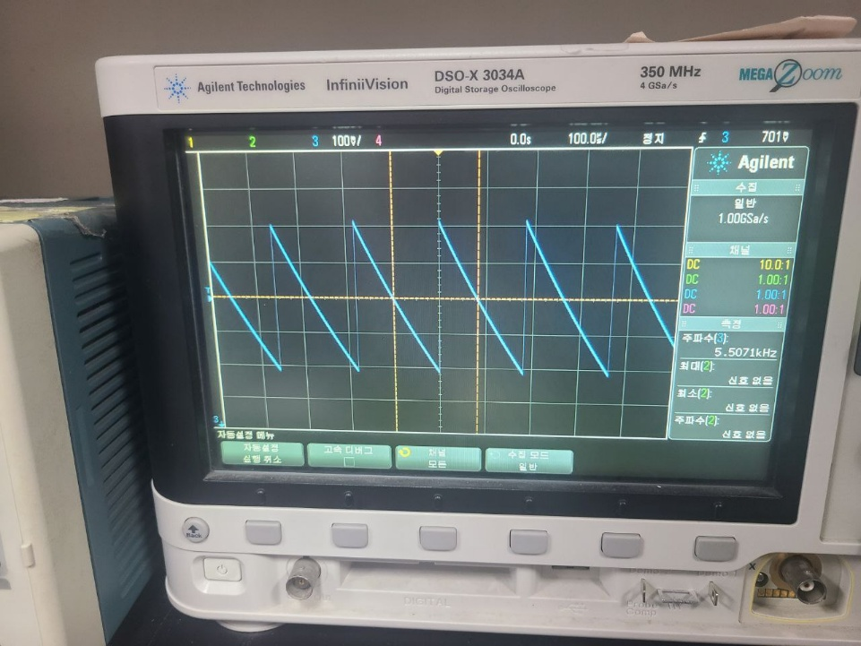
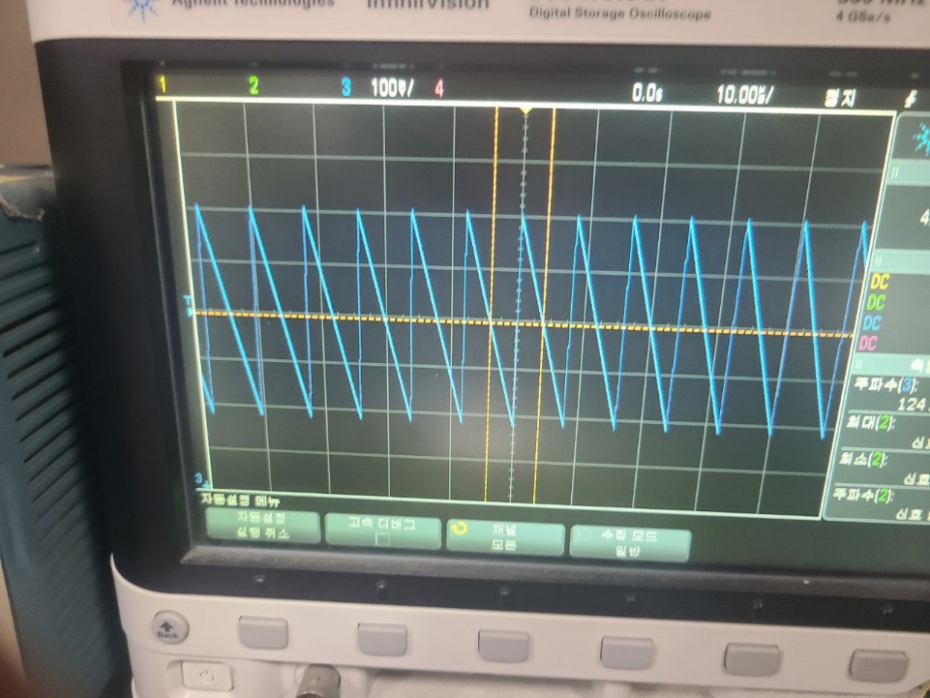
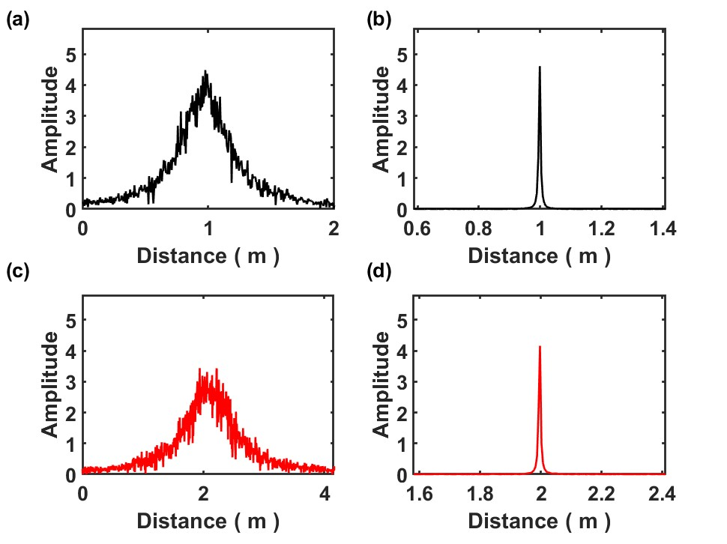
Electro-Optical Phase Locked Loop design for FMCW LiDAR TX in 28-nm CMOS
Do-Hyun Shin, Jin-Woo Hong, Jun-Seong Lee and Jin-Wook Burm
Department of Electronic Engineering, Sogang University
E-mail : Burm@sogang.ac.kr
Abstract
This Paper presents the Electro-Optical Phase Locked Loop(EOPLL) design process to stably drive distributed Bragg Reflector(DBR) Laser Diode in the Frequency-Modulated Continuous Wave Light Detection and Ranging(FMCW LiDAR) System. The Optical Circuit in the EOPLL consists of Laser Diode, Optical Coupler, and Pin Photodiode. It performs a function of Mach-Zehnder interferometer. Parameters of this optical circuit are extracted through experiments. I model the mathematical function of this optical circuit based on the extracted parameters by using Verilog-A and apply a loop filter design method of Type II PLL. Through Post-Simulation, it is confirmed that the PLL locks and the output frequency of the Laser is modulated linearly. It is designed using FD-SOI 28nm CMOS Process, and the gain current of the Laser Diode is 50mA. Polarization Maintaining Fiber (PM Fiber) is used for high SNR.
Introduction
Experiments
FMCW LiDAR System
Solution: EOPLL
  Controls laser input current → chirp slope linearization
  Optical path → acts as a differentiator
  Loop filter + integrator → VCO model (Type-II PLL)
* γ : modulation slope of the laser frequency
τ : time delay between 2 paths
ITL : driving current for the laser
KIF : laser frequency tuning gain
Fig 1. FMCW LiDAR Basic Diagram
Advantage
(1) Distance is obtained from frequency difference (Tx vs. reflected signal)
(2) Coherent detection → high SNR / high resolution at low clock frequency
Problem
(1) Laser diode shows nonlinear frequency–current slope
→ Tone broadening / frequency shifting
→ Degraded resolution & distance accuracy
(2) Phase jump occurs near TAP
Design Consideration
Gm variation vs voltage → loop stability tuning required
Triangular Wave Oscillator
  Implemented with Schmitt Trigger
  Slope reversal at 300mV / 700mV
  Output frequency: 10 kHz (off-chip capacitor)
Main Blocks
  PFD / Charge Pump / Loop Filter
  Triangular Wave Oscillator
  Voltage-to-Current Converter (Laser driver)
Charge Pump
  0.5% current mismatch @ 800mV compliance
  Rail-to-rail amplifier
  Gain ≥ 70 dB / UGB ≥ 740 MHz
  Power: 90 μW
Current Control
  Loop filter voltage → controls laser input current slope
  Constant-Gm + poly resistor used
Fig 2 (1). DBR Laser Diode Characteristics(Measured) (2). Beating Signal measured by oscilloscope
Fig3. FMCW LiDAR System Diagram
Results
Table1. Summary of this work
Method | Analog EO-PLL
Tech | 28nm CMOS
Power Consumption | 10μW
Laser | DFB
Wavelength | 1550nm
Detection Range | 0.1m to 3m
Chirp Rate (KHz) | 10
Chirp BW (GHz) | 25
lock time | 5μs
Fig4. EO-PLL Chip Layout using 28nm Process.
(a) f_beat > f_ref
(b) f_beat < f_ref
(a)
(b)
Fig5. Measured output waveforms when signals with frequencies higher (a) and lower (b) .
Fig6. FFT results ; (a) open loop (b) closed loop
Measurement Results
Measured output waveforms when signals with frequencies higher (left image) and lower (right image) than the reference are input to the IC, respectively
FFT Result : FWHM 411mm → 12mm
Analog IC confirmed that the beating frequency was locked within a settling time of 5 µs
Conclusions
This work presents an EOPLL-based FMCW LiDAR system that compensates for the inherent nonlinearity of laser frequency modulation by modeling the optical path as an equivalent VCO within a Type-II PLL framework. The proposed approach achieves a highly linear frequency sweep and effectively suppresses distortion near the tuning around points (TAPs). Measurement results confirm a strong linear relationship between beat frequency and target distance, demonstrating stable and accurate ranging performance. In addition, the system shows robust operation across PVT variations, while the AFE is optimized for SNR and ADC compatibility. Overall, the proposed architecture enables reliable and high-resolution LiDAR sensing.
Acknowledgment
This work was supported by the MSIT under Grant RS-2025-02653611 (Intelligent Semiconductor Technology Development Program), the IITP (Institute of Information & Communications Technology Planning & Evaluation)-ITRC (Information Technology Research Center) grant funded by the Korea government (Ministry of Science and ICT) (IITP-2026-RS-2023-00260091), Korea Institute for Advancement of Technology (KIAT) grant funded by the Korea Government (MOTIE) (P0017011, HRD Program for Industrial Innovation), Brain Korea Four Project, Samsung Electronics Co., Ltd. (IO201221-08244-01), National R&D Program through the National Research Foundation of Korea (NRF) funded by the Ministry of Science and ICT (RS-2021-NR057239), and K-Sensor Development Program of Korea Planning & Evaluation Institute of Industrial Technology (KEIT) grant funded by the Korean Government (MOTIE; grant number: RS-2022-00154782)

